Slide 1
The Reformation
1450-1650

Slide 2
Objectives
Students will be able to analyze the developments related to the Reformation, including new ways of thinking and the impact on later developments.
Martin Luther
Spread of Protestantism
Catholic Church
Henry VIII
Calvinism
Jesuits
Key Vocabulary
Reformation
Indulgence
Predestination
Theocracy

Slide 3
Problems for the Catholic Church
The Renaissance popes who ruled Rome from 1447 to 1534 patronized the arts, collected ancient manuscripts and defended the Papal states from French and Italian armies.
These worldly concerns left the popes little time for spiritual duties.
Many priests and monks were poorly educated that they could barely read.
Some village priests had semi-official wives. Pope Alexander VI publically acknowledged his own five children.

Slide 4
Problems for the Catholic Church
People began to expect higher standards of conduct from priests and church leaders.
During the Middle Ages, when few people were literate, a priest that could read was highly respected.
With the spread of learning, well-educated people began to look down upon the lowly priests.
Two groups demand reform and higher standards of religion.
Popular religious leaders that stirred the emotions of the people
Renaissance writers that become known as Christian humanists

Slide 5
Christian Humanists
Thomas More and Desiderius Erasmus were two well known Christian humanists.
Both men wrote books targeting the greedy merchants, heartsick lovers, quarrelsome scholars, and pompous priests.
Thousands of Europeans read the works of More and Erasmus.
The invention of the printing press gave these two authors the audience that they were seeking.
The printing press would come to change the world forever.

Slide 6
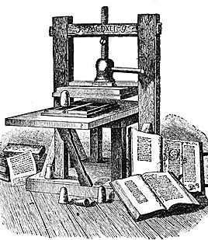
The Printing Press
The impact of the printing press can be compared to the television and computer.
A German named Johann Gutenberg was the first to print a bible around 1455.
Printing spread quickly throughout Europe.
The printing press changed religion in many ways.
Christians no longer had to rely on priests for interpretation.
The printed bible allowed for personal interpretation and reflection.

Slide 7
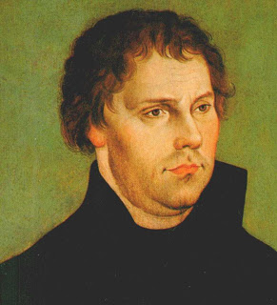
Luther Challenges the Church
1483-1546
Martin Luther wished only to be an obedient, God-fearing Christian.
The 95 theses
The selling of indulgences. (Friar Tetzel)
The Reformation

Slide 8
The Pope tries to silence Luther
Luther wanted a full reform of the church
His teachings were based on three main ideas:
Salvation by faith alone
The Bible as the only authority for Christian life.
The priesthood of all believers
On June 15, 1520, Pope Leo X issued a statement threatening to excommunicate Luther unless he changed his words and thoughts.
When Luther refused, he was excommunicated from the Catholic Church.

Slide 9
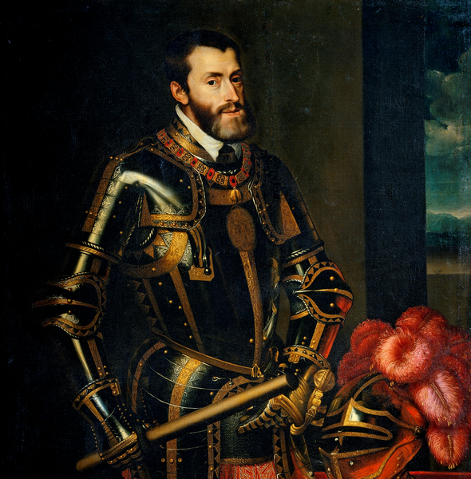
Holy Roman Emperor Charles V
Charles summoned Luther to Worms in 1521 to stand trial.
It was declared that Luther was an outlaw and a heretic.
Despite this ruling, Martin Luther lived comfortably for 25 years after his trial

Slide 10
Lutheran Ideas Spread
For almost a year after the trial, Luther shut himself away in the castle of Prince Frederick of Saxony.
He translated the New Testament into German.
Luther returned to Wittenberg in 1522 and found his ideas already being put into practice.
Supporters of the faith start a full revolt
Luther is outraged and horrified by their actions.

Slide 11
The German Princes
The princes’ armies crushed the peasant revolt of 1524.
Luther’s actions turned followers from the faith.
The success of Lutheranism was based on the princes’ support.
Supporters that followed Luther against the popes and the Catholic Church would become known as Protestants.

Slide 12
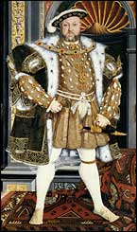
Henry VIII
The Protestant Reformation spreads across Europe.
Henry VIII was the son of the new monarch.
He was a devout Catholic and despised Luther.
Received a special title, “Defender of the Faith”

Slide 13
The Need for a Male Heir
Henry’s fear of being overthrown fueled his desire for a male heir.
Catherine of Aragon produced only one living heir, Mary
Henry picks out a new wife
In 1527, the king asked the pope to end the marriage.
Henry would have to take matters into his own hands

Slide 14
Calling Parliament
In 1529, Henry called Parliament and asked them to pass a group of laws that would strip away the pope’s power in England.
Parliament would legalize his divorce from Catherine.
Shortly after the marriage and crowning of Anne, she gives birth to another heir.
Through the actions of Parliament, Henry VIII was now the official head of England’s Church.

Slide 15
Henry enforces his changes
After Thomas More refused to support the Act of Supremacy, Henry had him executed to prove his stand against the pope.
He closed all English monasteries and seized their wealth and lands.
Nobles and the rising middle class purchased the seized lands. They would become the main supporters of the Protestant Reformation in England.
In the end, Henry remained more Catholic than Protestant in his rituals and doctrines.

Slide 16
The many wives of Henry VIII
Anne Boleyn would soon lose favor with the king and later be beheaded.
His third wife, Jane Seymour, died just twelve days after giving birth to his first male heir.
Henry would marry three more times. Anne of Cleves, Catherine Howard, and Catherine Parr.
His children would rule and carry on his legacy. First Edward, then Mary and then Elizabeth.

Slide 17
Queen Elizabeth I
Queen Elizabeth: The Virgin Queen

Slide 18
Calvin formalized Protestant Ideas
Calvin studied law and philosophy at the University of Paris.
Was under the influence of French followers of Luther.
Calvin would flee to Switzerland to escape arrest.
In his writings, he spoke of predestination and theocracy.

Slide 19
The Scottish Reformation
Calvin’s ideas would be spread to Scotland by John Knox.
The organization of the church would be led by Presbyterians.
The Queen of Scotland would be overthrown and replaced by her one year old son.
Calvinism would become the official religion of Scotland.

Slide 20
The Reform of the Catholic Church
Even though the Protestants had many followers, the Catholic church still had true and loyal followers.
One great champion of the Catholic reform was Ignatius.
Created an order known as the Jesuits.
Education of the faith, converting, and preventing

Slide 21
Pope Paul III and IV
Set forth doctrines that would change the Catholic Church.
Stated that the bible and the church were an equal authority for guiding a Christian’s life.
Made a list of banned books that were “dangerous” to the faith.
These books including the Protestant bibles were burned.

Slide 22
Counter-Reformation
Protestant historians referred to this time as the Counter-Reformation
Catholic historians refer to the time as the Catholic Reformation.
Religion would divide Europe.
Charles V had hoped for peace and unity
He gave up his crown to Phillip II and to his brother Ferdinand.

