Slide 1
Phonics
Chapter 5

Slide 2
Partial Phonics Glossary How Many of These Can You Define?
Analytic phonics
Blends/clusters
Closed syllable
Digraphs
Diphthong
Fricative consonants
Grapheme
Nasal consonants
Onset
Open syllable
Phoneme
Plosive consonants
R-controlled vowel
Rime
Schwa
Vowel digraph

Slide 3
Reflections on Struggling Readers
You sit down to read a book with your 8-year-old niece. As she tries to sound out unfamiliar words, you realize that she needs help with letter–sound relationships.
Do you think explicit phonics instruction would help her struggle less with her reading?
Or do you think that instruction in other areas would be more beneficial? Why?

Slide 4
How Teachers Can Help Struggling Readers
Interpret and respond to readers’ errors
Provide clear and simple examples for decoding and spelling
Organize and sequence instruction
Explain spelling patterns
Integrate language instruction

Slide 5
How Students Learn Phonics
Decoding words
Encoding words
Teacher modeling
Meaningful context:
“Phonics instruction disconnected from texts that children read contributes little to children’s use of phonics strategies in recognizing words.” (Hiebert, 1999, p. 556)

Slide 6
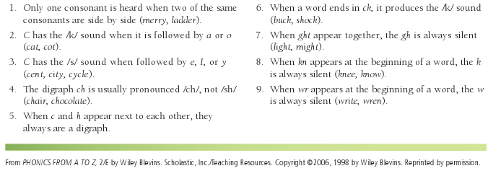
Generalizations About Consonants

Slide 7
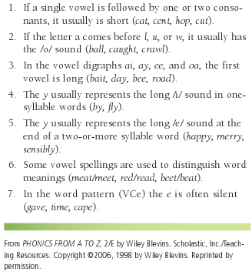
Generalizations about Vowels

Slide 8
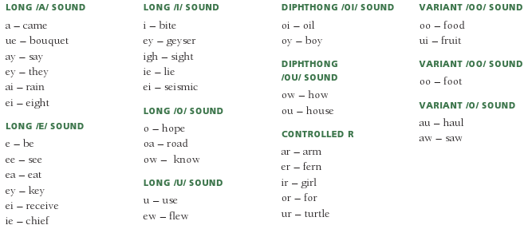
Various Spellings for Long Vowels and Diphthongs

Slide 9
English Learners and the Graphophonic System
English learners can have a difficult time learning the sounds of English letters, due to:
Orthography:
Deep orthography (e.g., English, French)
Shallow or translucent orthography (e.g., Spanish, Italian, and Portuguese)
Alphabet:
Languages that use other alphabets (e.g., Chinese, Vietnamese, Arabic, and Korean)

Slide 10
Further Reflections on Phonics
Have you ever known someone who was struggling to learn English (such as an exchange student)?
Were you able to help them understand confusing sounds in words such as “knife” and “weight”?
How will you use that experience to teach your own students—English learners as well as native-born children?

Slide 11
Principles of Phonics Instruction
Base instruction on what students know
Provide systematic instruction
Provide explicit and extensive instruction
Use appropriate texts
Embed instruction in meaningful contexts

Slide 12
Assessment of Phonics: Informal
Checklists
Surveys
Word sorts
Rubrics
Running records
Miscue analyses
Reading/spelling inventories

Slide 13
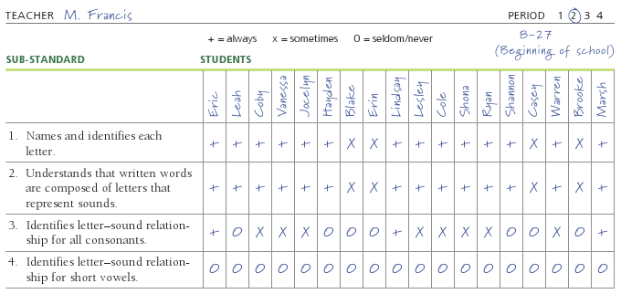
Letter–Sound Relationships Checklist

Slide 14
Assessment of Phonics: Formal
Standardized Tests with Phonics Subtests

Slide 15
Intervention Strategies Focusing on Phonics
Activities should be based on texts children have enjoyed and words they’ve encountered.
Emphasizing initial consonant sounds:
Word sorting with pictures
Listen for initial consonant blends
Word walls
Personalized word family dictionary
Alphabiography
Alliteration
Dominoes (continued)

Slide 16
More Intervention Strategies
Emphasizing onset and rime:
Word family word walls
Find the Mystery Word
Flip books
Word Family Concentration
Emphasizing rhyme:
Rhyming Word Concentration
Predictable rhyming texts
Yankee Doodle Poetry
(continued)

Slide 17
Sample Flip Books

Slide 18
More Intervention Strategies
Emphasizing word patterns:
Short Vowel Bingo
The Magical E!
Emphasizing words within words:
Secret Words
Emphasizing sounds within words:
Listening to the vowel sounds
Collecting vowel sounds with different spellings
Word sorting words
Change Hen to Fox
Word ladders

Slide 19
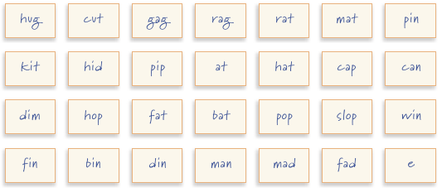
Magical E! Cards

Slide 20
Phonics and Technology
Resources for helping students build skills in phonics:
www.learningtoday.com/corporate/readinggames.asp
www.starfall.com
http://teacher.scholastic.com/clifford1/flash/phonics/
index.htm
www.learningplanet.com
www.suelebeau.com

Slide 21
Related Video Presentation
You can see a video of a teacher using the Phonics Mastery Survey (which is related to the discussion on page 112 of the chapter).

