Slide 1
Phonemic Awareness
Chapter 4

Slide 2
Phonemic Awareness Defined
“A child’s understanding and conscious awareness that speech is composed of identifiable units, such as spoken words, syllables, and sounds.”
IRA and NAEYC, 1998, p. 4

Slide 3
Reflections on Phonemic Awareness
Consider the following questions:
Is phonemic awareness necessary for students to become proficient readers?
Do students benefit from intense, explicit instruction?
If not through explicit instruction, how do children become aware of phonemes within words?
What do you think about the controversies surrounding teaching of phonemic awareness?

Slide 4
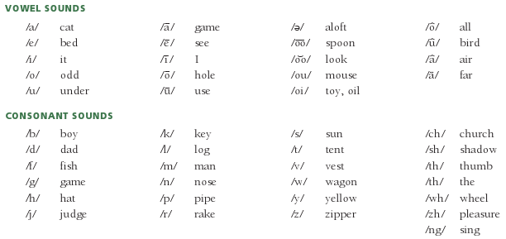
The Most Common Phonemes
Source: Adapted from Blevins (2001). Teaching Phonics and Word Study in the Intermediate Grades. New York: Scholastic.

Slide 5
Dimensions of Phonemic Awareness
Hearing syllables within a word
Hearing initial sounds/recognizing alliteration
Hearing rime and rhyme
Distinguishing oddity
Blending sounds orally to make a word
Segmenting words orally
Manipulating sounds orally to create new words

Slide 6
Phonemic Awareness and English Learners
Phonemes differ from one language to another.
Some languages have more phonemes, while others have fewer.
English has 44
Spanish has 24
Some phonemes exist in English and not in other languages; some languages have phonemes that don’t exist in English.

Slide 7
English Phonemes That Are Not Found in Spanish
Sources: Helman, L. A . (2004). Building on the sound system of Spanish: Insights from the alphabetic spellings of English-language learners. The Reading Teacher, 57(5), 452–460. Bear, D., Helman, L., Templeton, S., Invernizzi, M., & Johnston, F. (2007). Words their way with English learners: Word study for phonics, vocabulary and spelling instruction (4th ed.). Upper Saddle River, NJ: Pearson.

Slide 8
Opposing Viewpoints on Phonemic Awareness Instruction
One cannot separate the sounds from a word that has been uttered any more than one “can extract the ingredients from a cake that has been baked.”
Smith, 1999, p. 153
“Instruction with print with explicit attention to sound structure in spoken words is the best vehicle toward [language] growth.”
Cunningham et al., 1998, p. 3
What is your opinion?

Slide 9
Assessing a Child's Level of Phonemic Awareness
Kid watching/observation
Use commercial assessments
Use informal assessments

Slide 10
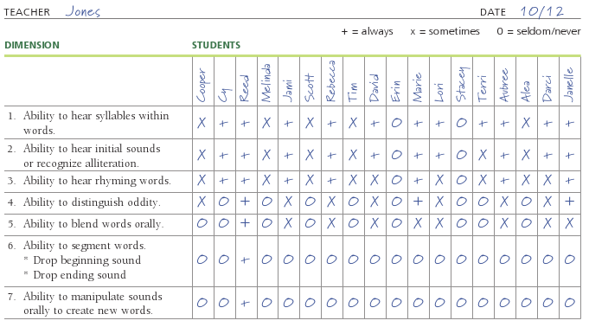
Checklist for Phonemic Awareness Primary Grades

Slide 11
Ways to Introduce Children to Language Sounds
Songs
Nursery rhymes
Poems
Jump rope jingles
Riddles and jokes
Tongue twisters
Stories that include rhyme, alliteration, onomatopoeia, and nonsense words

Slide 12
Intervention Strategies Focusing on Phonemic Awareness
With strategies/activities, emphasis should be on playing with language rather than teaching phonemic awareness.
Emphasizing syllables:
Clapping syllables to familiar songs and rhymes and multisyllable words
Let’s Make Music
How Many Syllables in the Zoo?
(continued)

Slide 13
More Intervention Strategies
Emphasizing initial sounds:
Sound boxes
Alphabet booklets
Spanish/English concept books
Remember the Beginning Sound!
Initial Sound Bingo
Toss the Cube
Go Fish
Tongue twisters
(continued)

Slide 14
More Intervention Strategies
Emphasizing rhymes:
Identifying rhyme in poetry
Humpty Dumpty board game
Clowning Around with Rhyming Words
Emphasizing oddity:
Odd-card out!
(continued)

Slide 15
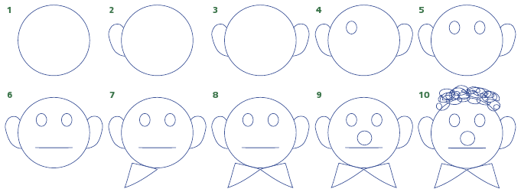
Steps for Clown Drawings

Slide 16
More Intervention Strategies
Emphasizing blending:
Children Are Sounds
Blending with puppets
Onset and rime blending card game
Blending individual sounds card game
Emphasizing segmenting:
Segmenting individual sounds card game
(continued)

Slide 17
More Intervention Strategies
Emphasizing deleting:
Pop Off the Beads!
Children and Sounds
Emphasizing manipulating:
Moving the Tiles

Slide 18
Phonemic Awareness and Technology
Resources for helping students build phonemic awareness:
www.learningtoday.com/corporate/readinggames.asp
http://teacher.scholastic/com/clifford1/flash/phonics/
index.htm
www.readinglady.com
www.readwritethink.org
www.pbskids.org

Slide 19
Related Video Presentation
You can see a video presentation of a phonemic awareness pretest (which is related to the discussion on pages 83–84 of the chapter).

