Slide 1
Comprehension of Informational Text
Chapter 9

Slide 2
Reflections on Informational Text
Do you recall going through a slump in your reading development, when you lacked the motivation and skills to read a textbook?
If so, how did you get over that slump?
How will you motivate your students to read informational text, especially if:
They lack necessary skills.
They say they want to read only stories/narrative text, not nonfiction.

Slide 3
Factors Affecting the Comprehension Process
Within the reader
Within the reader’s environment
Within the text

Slide 4
Necessary Skills for Understanding Informational Text
Knowledge of organizational patterns
Adequate background knowledge
Knowledge of specific terms
Ability to analyze the author’s purpose and credentials
Ability to synthesize similar information from various sources
Prior knowledge and experience
Personal interest

Slide 5
Skilled vs. Unskilled Readers of Informational Text
Take a look at Figure 9.1, on page 219 of the textbook.
Do you think some skills are more important than others? Which ones? Why?

Slide 6
Comprehension Factors in the Reader’s Environment
Home/parents and caregivers
Community
School/effective teachers

Slide 7
Organizational Structure of Expository Text
Chronology or sequence
Description or enumeration
Listing
Classification or hierarchy
Comparison/contrast
Cause/effect
Problem/solution
Persuasion

Slide 8
Elements to Consider in an Informational Book Analysis
Eye appeal
Text features—and whether it’s a traditional book or ebook
Author’s writing style
Use of technical vocabulary
Assumptions about readers’ background knowledge
Readability

Slide 9
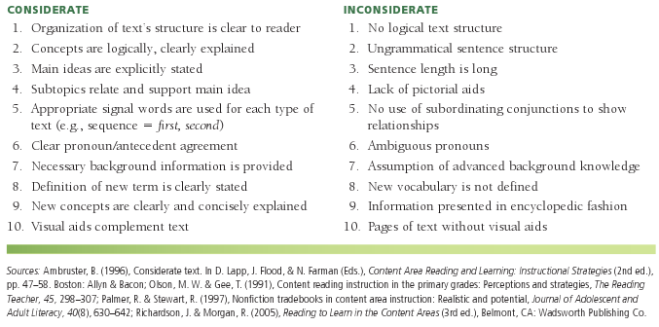
Considerate vs. Inconsiderate Textbook Styles

Slide 10
Instructional Recommendations for English Learners and Expository Texts
Help students understand vocabulary and technical terms
Give them time to ask questions and discuss materials
Use small group instruction
Base instruction on regular classroom topic, but choose easier books

Slide 11
Selecting Informational Texts for English Learners
Texts should:
Contain reference guides
Be well organized
Have charts, graphs, diagrams, photos, and other illustrations
Fit students’ background knowledge
Have plenty of white space on the page
Introduce new vocabulary in highlighted text (e.g., boldface)

Slide 12
Critical Literacy and Informational Texts—Questions to Consider
Does the author present the dominant or minority point of view?
Is the language biased?
What assumptions are formed about different groups? Are they unfair or harmful?
Are there students in the class who represent a race that isn’t mentioned in the book?
What can the class do as a call to action?

Slide 13
Assessment of Informational Texts: Informal
Informal reading inventories (IRIs)
Rubrics
Running records and miscue analysis
Cloze/maze procedures
Reading interest surveys
Assessment of background knowledge
Vocabulary assessment
Assessing readers’ growth

Slide 14
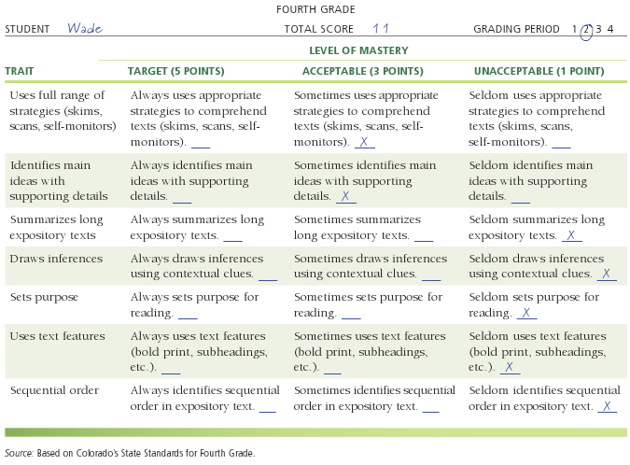
Rubric for Reading Comprehension

Slide 15
Assessment of Informational Texts: Formal and Critical Literacy
Formal:
Norm-referenced achievement tests
Criterion-referenced tests
Critical thinking skills:
Interpretation
Inference
Evaluation
Analysis
Self-regulation
Deductive and inductive reasoning

Slide 16
Intervention Strategies Focusing on Expository Comprehension
To use before, during, and after reading:
Textmasters
Science experiments, crafts, and math games
Read-alouds
Partner Reading and Content Too (PRC2)
Graphic organizers
Lesson cycle
(continued)

Slide 17
More Intervention Strategies Before, During, and After Reading
K-W-L charts
Guided reading strategy
Inference training
Question-answer relationships (QAR)

Slide 18
Sample Graphic Organizer—Description Based on Box Turtle at Long Pond

Slide 19
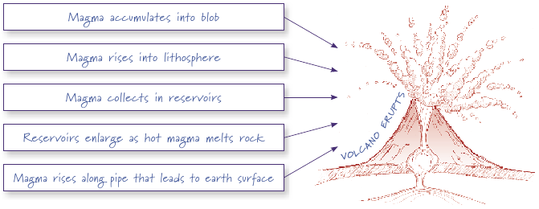
Sample Graphic Organizer—Cause & Effect Based on Earthquakes and Volcanoes

Slide 20
More Intervention Strategies
To use before reading:
Survey of text features
Pre-reading plan (PreP)
To use during reading:
Think-alouds
Checklists
ReQuest
To use after reading:
Scanning
Learning logs
Collaborative approach
Question Connect Transform (QCT) for expository text

Slide 21
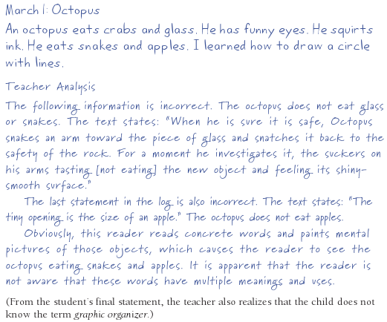
Learning Log Entry and Analysis

Slide 22
Basic Skills Needed When Using the Internet
Locate materials
Identify important questions
Use search engines
Refine search words
Read and evaluate descriptions in search engine results
Evaluate site or author’s credibility
Use the “Back” button
Read and comprehend text
Take notes from sites
Synthesize material
Cite sources

Slide 23
Some Useful Websites
For Internet scavenger hunts:
Internet Treasure Hunts for English learners (http://iteslj.org/th)
Searching for Treasures on the Internet (www.education-world.com/a_curr/ curr113.shtml)
A search on the term webquest
For expository text:
http://kids.nationalgeographic.
com/kids
www.kidsbiology.com
www.readwritethink.org
http://water.epa.gov/learn/kids
www.sciencekids.com
www.apples4teachers.com/
science
www.brainpop.com/science
www.kidsknowit.com

Slide 24
Related Video Presentation
You can see a video presentation of the author working with a student to complete a K-W-L chart (which is related to the activities on pages 246–247 of the chapter).

