Slide 1
Comprehension of Narrative Text
Chapter 8

Slide 2
Reflections on Reading Comprehension
Consider this passage: Teachers “need to marinate students in a new skill if it is to become permanent knowledge” (Flynt & Cooter, 2005, p. 775).
Do you agree?
Will you be inclined and prepared to try a variety of strategies and activities with a student if the first one you try doesn’t seem to work?

Slide 3
Strategies Readers Use to Understand Text
Draw inferences
Predict
Self-monitor
Retell and summarize
Activate prior knowledge
Draw conclusions
Use knowledge of text structures
Visualize before, during, and after reading
Ask questions

Slide 4
Reading Skills
Decoding
Fluency
Vocabulary

Slide 5
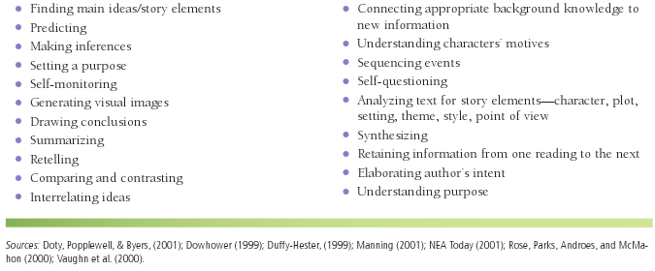
Strategies for Reading Comprehension

Slide 6
Reading Strategies— Before and During Reading
Before reading:
Predicting
Setting a purpose
During reading:
Making inferences
Self-monitoring
Visualizing
Connecting prior knowledge to texts

Slide 7
Connecting Prior Knowledge to Texts— Background Knowledge
Literary background (text-to-text connection)
World knowledge (text-to-world connection)
Life experiences (text-to-self connection)

Slide 8
Reading Strategies— After Reading
Retelling story elements
Drawing conclusions
Elaborating on the author’s intent

Slide 9
Comprehension and Critical Literacy
Goal of critical literacy is for teachers to “encourage students to recognize connections between their lives and the lives of real or imagined story characters . . . to explore authors’ possible biases, and to reflect on how to take social action to create a more compassionate world” (Richards, 2006, p. 193).
Do you believe it is a teacher’s responsibility to help students learn how to “create a more compassionate world”? Why or why not?

Slide 10
Critical Literacy Themes
Recognize social barriers, or how barriers have been broken
Examine multiple perspectives of historical events
Look at the language of the text and explore how language can be used to change situations
Juxtapose two contrasting texts
Find one’s identity by discussing differences within the classroom and examining ways to overcome prejudices
Find ways to take action

Slide 11
Questions to Encourage a Critical Stance

Slide 12
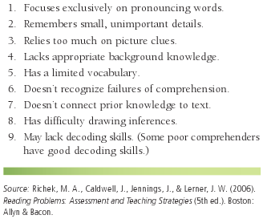
Behaviors and Characteristics of Poor Readers (Richek et al., 2006)

Slide 13
Behaviors and Characteristics of Poor Readers (Richek et al., 2006)
Focus exclusively on pronouncing words.
Remember small, unimportant details.
Rely too much on picture clues.
Lack appropriate background knowledge.
Have a limited vocabulary.
Don’t recognize failures of comprehension.
Don’t connect prior knowledge to text.
Have difficulty drawing inferences.
May lack decoding skills.

Slide 14
Assessment of Narrative Comprehension: Informal
Informal reading inventories (IRIs)
Miscue analysis
Retrospective miscue analysis
Running records
Retelling
Think-alouds
Cloze/maze tests
Rubrics
Computer programs

Slide 15
English Learners and Narrative Texts
Recommendations for instruction:
Explicit
In depth
At a slower pace
With opportunities for discussion and response

Slide 16
Selecting Narrative Texts for English Learners
Based on students’ cultures
Have chronological story lines
Contain few colloquial expressions
If appropriate, have themes based on fitting in or being different
Teach everyday survival topics, such as days of the week/month or types of clothing
Have predictable story lines
Have illustrations that advance the story

Slide 17
Teaching Comprehension Strategies to Poor Readers
Teach in context
Use simple reading material
Individualize
Choose an appropriate strategy
Teach the strategy explicitly
Model using the strategy
Give appropriate feedback
Provide numerous opportunities for practice
Don’t present multiple strategies at one time
Have the student verbalize the steps of the strategy

Slide 18
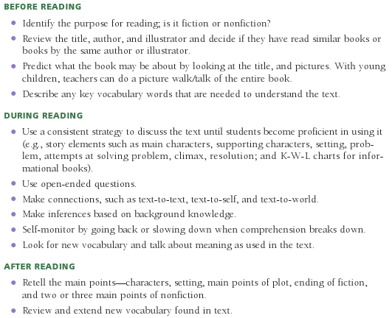
Before, During, & After Reading Strategies (Santoro et al., 2008)

Slide 19
Intervention Strategies Focusing on Narrative Comprehension
To use before, during, and after reading:
Pairing nonfiction and fiction texts
The Memphis Comprehension Framework
Repeated interactive read-aloud
Story lines
To use before reading:
Alternate writing
Directed listening–thinking activity (DL–TA)
Directed reading–thinking activity (DR–TA)
(continued)

Slide 20
More Intervention Strategies
To use during reading:
Text mapping
Reciprocal questioning
Think-aloud for narrative text
Think-aloud mystery
“And this is the rest of the story”
Teacher-made audiobooks
Text-talk
Wordless books for developing inferential reading
(continued)

Slide 21
More Intervention Strategies
To use after reading:
Repeated readings
Different perspectives: Diary entries
Painting mental pictures
Spin the discussion
Graphic organizers
Retelling with puppets
Question Connect Transform (QCT)
Character perspective chart
Venn diagrams
Character sketch

Slide 22
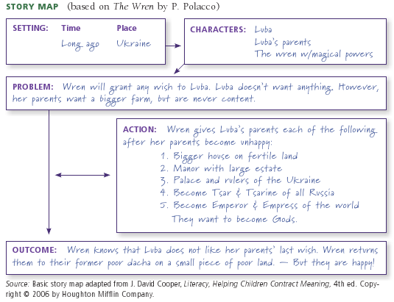
Sample Story Web (Story Map)

Slide 23
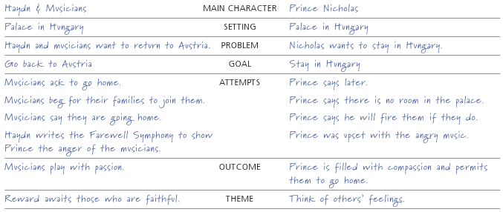
Character Perspective Chart For Characters in The Farewell Symphony

Slide 24
Technology and Comprehension of Narrative Text
E-readers:
Fascinate many students
May help reluctant readers become interested in reading
Allow readers to build on present knowledge through active involvement with the story
Use caution:
Readers may get caught up in the animation and not follow the story
Readers may lose interest if the story isn’t engaging

Slide 25
Related Video Presentation
You can see a video presentation on assessing comprehension using a miscue analysis (which is related to the discussion on page 190 of the chapter).

