Slide 1
Vocabulary Building
Chapter 7

Slide 2
Reflections on Vocabulary Building
How do you feel when you’re at a meeting or in class where everyone is using jargon with which you are not familiar?
Do you ask someone to explain what they’re talking about, or do you try to determine meaning from the context?
Do you ever find yourself using jargon with friends or colleagues? Do you define your words when a new person joins the group?

Slide 3
When Teaching Vocabulary Teachers Need to Know…
How proficient readers naturally enrich their vocabulary
How to teach vocabulary explicitly
How to meet the vocabulary needs of English learners
How to assess struggling readers’ vocabulary

Slide 4
Word Tiers
Tier one words:
Common words used in everyday conversation (house, car, sleep)
Tier two words:
Less frequent, but interesting words (persuade, exhausted)
Tier three words:
Rare words that are used in a particular context (psycholinguistic, paradigm)

Slide 5
Aspects of Knowing a Word
How to pronounce it correctly
How it relates to other words
How it is used in various contexts
How to use it in multiple settings
How to use it when writing
How it may have multiple meanings
How to know its morphology (derivation)

Slide 6
Ways to Increase Vocabulary
Life experiences
Vicarious experiences:
Educational videos, TV, Internet, variety of books and texts, etc.
Direct, or explicit, instruction
How do you increase your own vocabulary?
Books? Television/movies? Word-of-the-day emails?

Slide 7
Guidelines for Explicit Vocabulary Instruction (Flynt and Brozo, 2008)
Choose words students need to know
Expose students to selected words several times, and use the words in discussion
Teach students to infer word meaning by looking for context clues and word parts
Use vocabulary maps and word association to demonstrate relationships among words
Teach students how to analyze words and derivations
Teach students multiple meanings of words

Slide 8
More Guidelines for Explicit Instruction
Teach new words
Teach word-learning strategies
Context clues
Word hierarchies
Language concepts

Slide 9
Language Concepts and Hierarchies
Synonyms
Antonyms
Homophones
Neologisms
Portmanteaus
Acronyms
Euphemisms
Oxymoron
Regionalisms
Puns
Onomatopoeia

Slide 10
Meeting the Vocabulary Needs of Struggling Readers
Use word play to help them develop a love of words.
Teach important words, discuss them, and revisit them often.
Teach strategies so students can decipher new words as they encounter them.
Provide a wide range of texts in a variety of contexts:
Literature circles, guided reading groups, shared reading, book clubs

Slide 11
Meeting the Vocabulary Needs of English Learners
Implement instruction that builds from one grade to the next
Teach high-frequency words in phrases
Teach higher-level or academic words
Teach strategies that help learners infer word meanings
Be real when teaching new words and definitions:
Real objects, visual images, graphic organizers, drama
Engage students in activities that will help them learn new words

Slide 12
Accepting Students and Their Limited Vocabulary
Be patient
Work to develop students’ oral/aural language abilities and their reading skills simultaneously
Provide students with help in an environment that focuses on strengths and successes and that minimizes weaknesses

Slide 13
Assessment of Vocabulary
Informal assessment
Conversation and observation
Cloze tests
Maze tests
Zip tests
Synonym tests
Checklists
Formal assessment
Standardized achievement tests
Group diagnostic tests
Individual diagnostic reading tests

Slide 14
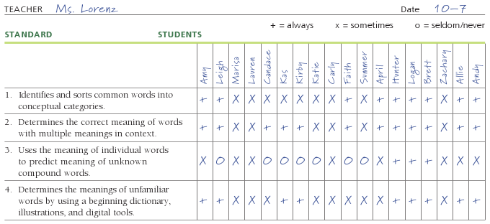
Vocabulary Growth Checklist For First Grade Based on Florida State Standards

Slide 15
Intervention Strategies and Activities
Use a variety of strategies to prevent students from becoming complacent
Make activities enjoyable and engaging
Teach words in context:
Associate words with the topic being studied, so they will be used and remembered.

Slide 16
Intervention Strategies Focusing on Building Vocabulary
Vocabulary bookmarks
Predict-o-gram
Figurative speech
Language experience approach (LEA)

Slide 17
Language Experience Approach (LEA)
An effective technique for:
Introducing students to oral vocabulary in written form
Teaching literacy
Reading, writing, and other language arts are viewed as interrelated
Students’ experiences used as basis for reading

Slide 18
Variations on LEA
Wordless books
Science experiment
Listening walk
Schoolyard safari
Total Physical Response (TPR)
Categorizing

Slide 19
More Intervention Strategies Focusing on Building Vocabulary
Possible sentences
Analogies
Origin of words
Crossword puzzles
Synonym/Definition Concentration
Cognate picture cards
Multiple Meaning Racetrack
(continued)

Slide 20
Crossword Puzzle Based on Literary Terms

Slide 21
More Intervention Strategies
Hink Pinks
Lexical and structural riddles
Word Expert Cards
Collaborative activities
Music Puzzlers
Matching Game
Two Cube Game
Pictionades
Action Jeopardy

Slide 22
Vocabulary Building and Technology
Ebooks:
Feature verbal word pronunciations and definitions
Can read to the student, or can be set so the student reads the text
Include games
Websites:
www.languageguide.org/
english
www.point4teachers.com
www.discoveryeducation.com/freepuzzlemaker

Slide 23
Related Video Presentation
You can see a video of the Concentration activity in action (Teaching Vocabulary Through Synonym/Vocabulary Concentration; this is related to the activity shown on pages 169–170 of the chapter).

