Slide 1
Word Identification
Chapter 6

Slide 2
The Brain and Word Recognition
The brain is capable of identifying only four or five random letters (e.g., w, q, e, j) per second.
When letters are organized into words (e.g., basket, sneeze, California), the brain approaches them as chunks of information.
When words are organized into grammatically correct sentences (e.g., I love to read), the brain processes four times the amount it can handle when identifying random letters.

Slide 3
Elements of Word Recognition (Pinnell and Fountas, 2007)
Recognizing words without conscious attention
Recognizing words without attending to every letter
Using parts of words to quickly identify new words
Connecting unknown words to known words (analogies)
Connecting spelling with word meaning (homonyms, plurals, tenses, etc.)

Slide 4
Corrective Reading Instruction with Struggling Readers
Help readers:
Learn how to use the four cueing systems
Learn the components of word identification
Increase their range of strategies for analyzing words

Slide 5
The Four Cueing Systems
Syntactic
Semantic
Pragmatic
Graphophonic

Slide 6
Reflections on Word Meanings
Consider the many meanings of the word “run.” How could you help a struggling reader identify the meaning of the word in a particular sentence?
Run as fast as you can!
The ski run is fast and challenging.
Mary is running for class president.
The running water sounds cool and refreshing.
The baby’s runny nose needs to be wiped.

Slide 7
Components of Word Identification
Word knowledge:
Receptive / expressive vocabulary
Sight words (e.g., the, to, you, there, once)
Sight vocabulary
Word analysis skills:
Context clues
Visual analysis of monosyllabic words
Blending polysyllabic words
Structural analysis

Slide 8
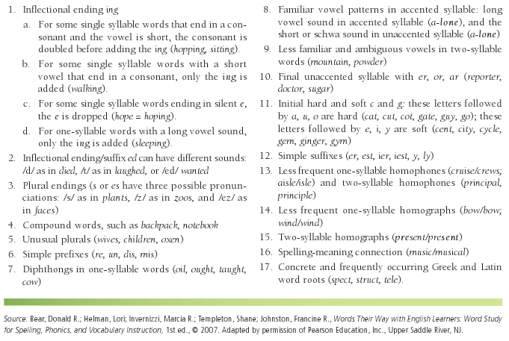
Teaching Syllables and Affixes to English Learners

Slide 9
Assessment of Word Identification: Informal
Checklists
Receptive vocabulary
Sight words / sight vocabulary
Context clues
Visual analysis
Blending
Structural analysis

Slide 10
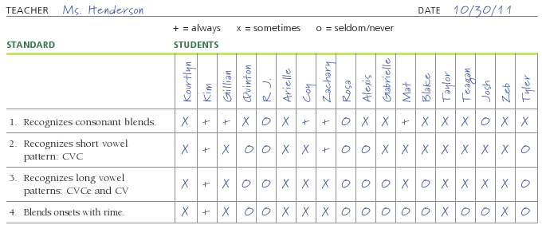
Checklist for First Grade Based on California’s Standard 1.10

Slide 11
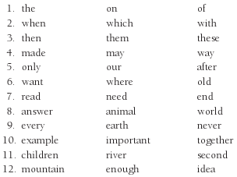
Sample List for Assessing Sight Vocabulary

Slide 12
Assessment of Word Identification: Formal
Diagnostic Tests Used to Assess Sight Words

Slide 13
Intervention Strategies Focusing on Word Identification
Activities should help readers think about words
Skills should be taught in context
Activities should be used in small group settings or in tutoring sessions
Small group activity for teaching word identification skills: Guided reading
(continued)

Slide 14
More Intervention Strategies
Emphasizing receptive and expressive vocabularies:
Wordless books
Picture books
Using vocabulary to enhance middle school students’ expressive vocabulary
Emphasizing sight words:
Match the Word
Dolch List Bingo
(continued)

Slide 15
More Intervention Strategies
Emphasizing sight vocabulary:
Unscramble the Sentence
Personalized flash cards
Personal word walls
Unscramble the Word
Technical terms
(continued)

Slide 16
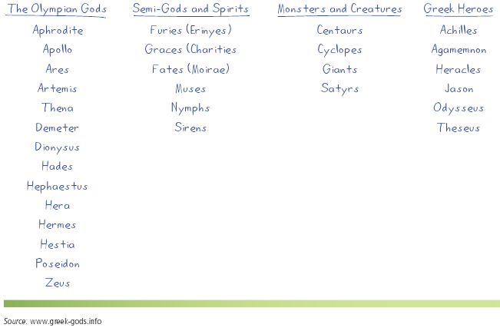
Sample Word Organizer

Slide 17
More Intervention Strategies
Emphasizing content clues:
Cloze passages
Emphasizing visual analysis of monosyllabic words:
Toss the Cube
(continued)

Slide 18
More Intervention Strategies
Emphasizing blending polysyllabic words and structural analysis:
Compound words
Affixes word study
Personalized word-part dictionaries: affixes and roots
Morphology Rummy

Slide 19
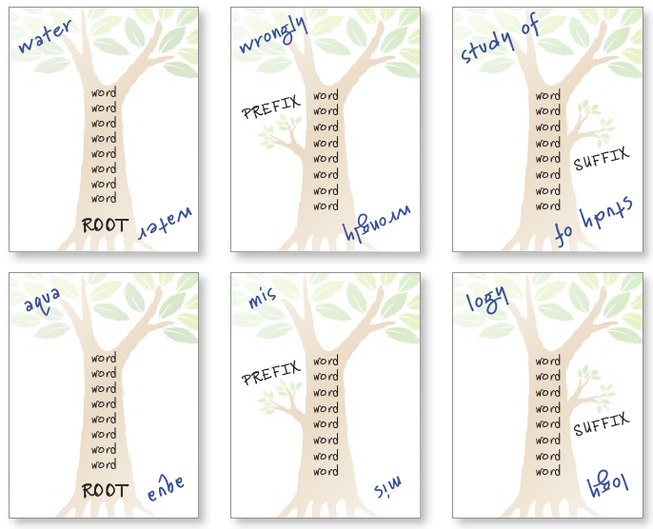
Sample Morphology Rummy Cards

Slide 20
Word Identification and Technology
Resources to help children with word identification:
Interactive books
Audiobooks
CDs/DVDs
Interactive websites
Favorite sites to help build word recognition skills:
www. readingrockets.org
www.funbrain.com
www.prongo.com
www.starfall.com
www.primarygames.com/ reading.htm
www.pbskids.org

Slide 21
Reflections on All Types of Readers
Imagine that you have a class with a number of gifted and talented students—all of whom learned to read at a young age—together with several struggling readers.
How will you be able to give enough time and attention to the struggling readers while making sure the more gifted readers aren’t bored?

Slide 22
Related Video Presentations
You can see a video of a teacher assessing sight words with high frequency phrases (which is related to the discussion on pages 133–134 of the chapter).

