Slide 1
Assessment
Chapter 3

Slide 2
Reflections on Assessment
Consider the various pros and cons of assessment.
What benefits does it offer?
What are its drawbacks?
What did you think of the various tests (especially the standardized ones) you had to take when you were in school?

Slide 3
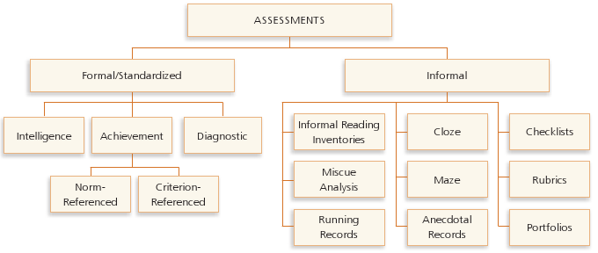
Types of Assessments

Slide 4
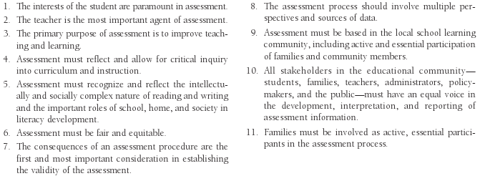
NCTE/IRA Standards for Assessment of Reading and Writing
From Standards for the Assessment of Reading and Writing by the International Reading Association and the National Council of Teachers of English, Copyright ©2009 by the International Reading Association and the National Council of Teachers of English. Reprinted with permission. Visit www.ncte.org/standards/assessmentstandards for the complete standards.

Slide 5
Formal/Standardized Assessments
Intelligence tests
Achievement tests
Diagnostic tests

Slide 6
Advantages/Disadvantages of Standardized Tests
Primary advantages:
Indicate whether an individual student needs additional screening
Designed for validity and reliability
Primary disadvantages:
Students can guess at the answers, which results in inaccurate scores
Students might be able to answer questions without understanding a passage

Slide 7
Accommodations for English Learners When Taking Standardized Tests
Make language understandable
Give them more time
Give the test orally
Give the test in student’s own language, if possible
Allow students to use spell check
On multiple-choice tests, reduce options to two
On fill-in-the-blank questions, provide a word bank
Interpret idioms
Simplify directions
Use a peer interpreter

Slide 8
Informal Assessment Instruments
Gauge what an individual student can do
Diagnose reading problems
Check reading levels
Analyze which cueing systems are being used
Highlight a student’s interests and attitudes toward reading/writing
Monitor growth
Allow a student to reflect on literacy accomplishments
Allow a student to set realistic goals
Help a teacher plan for instruction

Slide 9
Emergent and Beginning Readers

Slide 10
Informal Reading Inventories (IRIs)
Purpose:
Determine reading level of child based on miscues
Determine reading comprehension based on retelling
Types:
Lists of leveled words, phrases, or sentences
Sets of graded reading passages with accompanying questions

Slide 11
Miscue Analysis
Analyzes the degree to which “miscues change, disrupt, or enhance the meaning of a written text.” (Goodman, Watson & Burke, 1987, p. 5)
Types of miscues:
Substitutions
Mispronunciations
Repetitions/insertions
Omissions

Slide 12
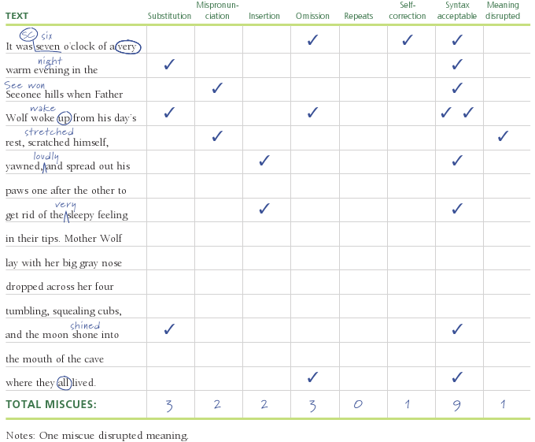
Conventions Used for Miscue Analysis

Slide 13
Running Records
Give teachers the opportunity to observe, score, and interpret students’ reading behaviors.
Objectives:
Determine a student’s instructional level
Analyze cues used/neglected during oral reading
Analyze a student’s strategic processing of a text
Use the results to plan for individual instruction

Slide 14
Qualitative Analysis of a Running Record
Determines which cueing system the student used when making an error:
Semantic—“Does this error make sense in the sentence?”
Syntactic—“Does that sound right in the sentence?”
Visual or graphophonic—“Does the error look like the word in the text?”

Slide 15
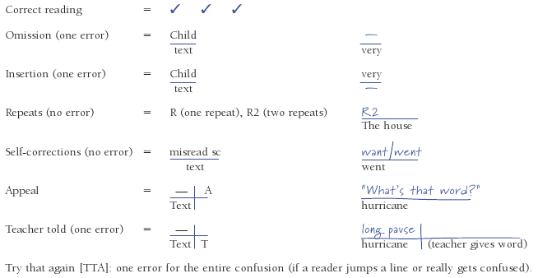
Running Record Conventions

Slide 16
Cloze Tests
Purpose is to help teachers:
Understand how readers use context and background knowledge to determine unknown words
Determine the reading level for a particular text

Slide 17
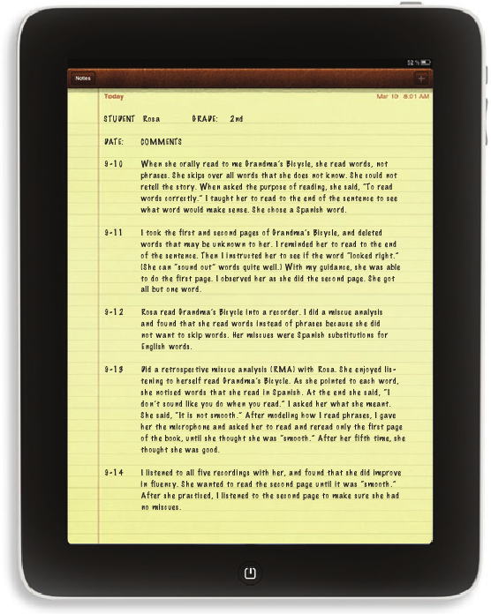
Sample Anecdotal Record

Slide 18
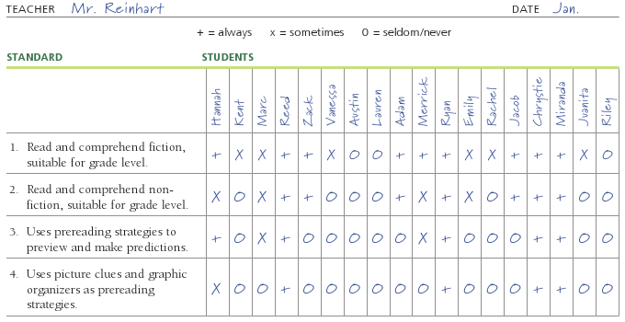
Checklist for Second Grade Based on Oklahoma Standards

Slide 19
Rubrics
List competencies that students are expected to master
Act as scoring guides for particular assignments or for particular evaluation periods
Show growth in a particular area
Identify the weaknesses of individual students

Slide 20
Portfolios
Collections of students’ work
Purpose:
Organize materials
Document growth
Display exemplary work
Types:
Working, growth, best-work
Can be electronic or in a physical format

Slide 21
Authentic Assessments with English Learners
Measure the student’s knowledge base (through interviews)
Allow the student to demonstrate knowledge using non-language methods
Observe the student
Use the language experience approach (LEA)

Slide 22
Surveys
Personal interest surveys
Attitude surveys
To determine a student’s particular likes and dislikes of reading/writing
To help a student build a more positive attitude

Slide 23
Student Self-Assessment Instruments
Book logs
Skill logs
Reflection logs
Accomplishment and goal-setting logs

Slide 24
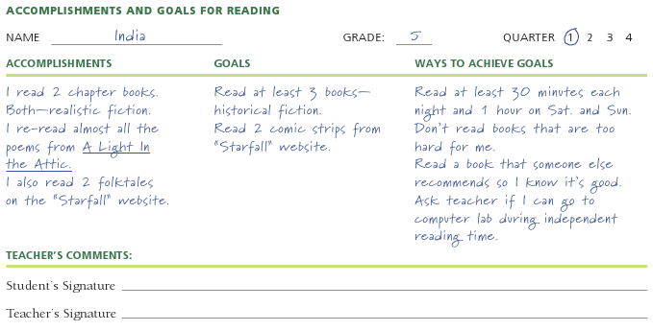
Sample Accomplishment and Goal-Setting Log

Slide 25
Technology and Assessment
Free resources for teachers to assess students in different areas of literacy:
Frontline Phonics (www.frontlinephonics.com)
Test 4 Free (www.test4free.com)
Vocabulary Test (www.vocabtest.com)
Learningable Kids (www.learningablekids.com)
World-English (http://world-English.org)

Slide 26
More Reflections on Assessment
Think back to when you took standardized tests in school.
Did test-taking make you nervous?
How did a teacher’s attitudes about the test and its results affect you?
How can you, as a teacher, make test-taking a pain-free experience for your own students?

Slide 27
Related Video Presentation
You can see a video of the author demonstrating the running records analysis (which is related to material on page 56 of the text).

