Slide 1
The Literacy Event
Chapter 2

Slide 2
Qualities of Effective Teachers
Think about the good teachers you have had or have observed.
In your opinion, what made them effective?
Think about teachers you have had or have observed who were not effective or were uninspiring.
What made them ineffective?
How can you learn from their mistakes?

Slide 3
Components of a Literacy Event― Create a Meaningful Learning Experience
Teachers
Students
Text
Context
Task

Slide 4
Critical Qualities of Excellent Literacy Teachers (IRA, 2000)
Believe all children can learn to read and write
Relate reading instruction to children’s previous experiences
Know different ways to teach reading, and when and how to use each method
Offer a variety of materials and texts
Use flexible grouping strategies
Continually assess students’ abilities and adjust instruction accordingly

Slide 5
Characteristics of Effective Literacy Teachers (Allington, 2002)
Engage students in reading/writing authentic passages
Give students texts that interest them
Model effective strategies
Pose higher-level thinking questions
Give students tasks that require them to integrate reading, writing, thinking, speaking, and listening
Grade process and product through rubrics

Slide 6
Reflections on Effective Teachers
Think about the qualities of effective teachers as defined by IRA (2000) and Allington (2002).
Do you agree with these qualities? Why or why not?
Would you add or delete any?
What challenges do you anticipate in becoming an effective teacher yourself?

Slide 7
Ways to Differentiate Instruction
Through pretesting, teachers can determine what concepts students know, or don’t know.
Teachers can vary instruction based on students’ abilities.
Students can produce a variety of products based on a variety of activities.
Teachers can adapt the learning environment to accommodate individual needs.

Slide 8
Reflections on Motivation
What motivates you to persevere with a difficult concept and finally make sure you understand it?
How will you motivate your own students to learn?

Slide 9
Possible Reasons for the Decline in the Motivation to Read
Self-consciousness about reading proficiency
Emphasis on competition
Lack of interest in assigned reading

Slide 10
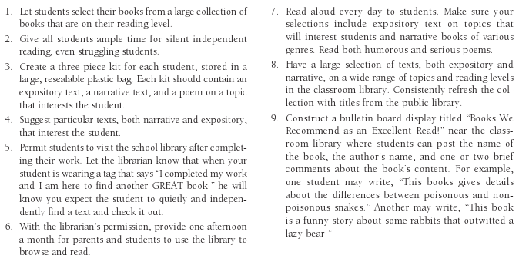
Recommendations to Motivate Student Reading

Slide 11
Motivators for Middle School Students

Slide 12
How Students Differ
Background knowledge and how they integrate new information
Literacy knowledge
The language systems they use
Learning styles
Multiple intelligences

Slide 13
Elements Making Up Literacy Knowledge
Skills
Strategies
Metacognition

Slide 14
Language Systems
Syntax
Semantic
Graphophonic
Pragmatic

Slide 15
Levels of Text Readability
Independent reading level
95 to 100% accuracy
Instructional reading level
90 to 95% accuracy
Frustration reading level
Less than 90% accuracy

Slide 16
Howard Gardner's Multiple Intelligences
Linguistic
Logical-mathematical
Spatial
Kinesthetic
Musical
Intrapersonal
Interpersonal
Naturalistic
Existential

Slide 17
Selecting Appropriate Texts
Select texts that bring students enjoyment and meaning
Choose interesting texts
Be certain they are accurate
Choose texts with accurate and diverse multicultural representations
Choose texts from a range of genres
Choose texts at each reading level
(continued)

Slide 18
Selecting Appropriate Texts, continued
Choose texts with high-quality illustrations
Choose texts with complementary text and illustrations
Select texts of an appropriate length
Use challenging instructional reading-level texts
Use easy reading-level books for fluency and to build comprehension

Slide 19
Leveled Books
Age leveling
Grade leveling
Lexile leveling
Gradient leveling

Slide 20
Fry Readability Formula
Randomly select three 100-word passages.
Count the number of syllables in each passage and find the average number of syllables in the three passages.
Count the number of sentences, estimating length of the fraction of the last sentence to the nearest one-tenth.
After finding the number of sentences in each passage, find the average number for the three passages.
On the Fry Readability Graph, plot the average number of syllables and average number of sentences to identify the estimated reading level of the book.

Slide 21
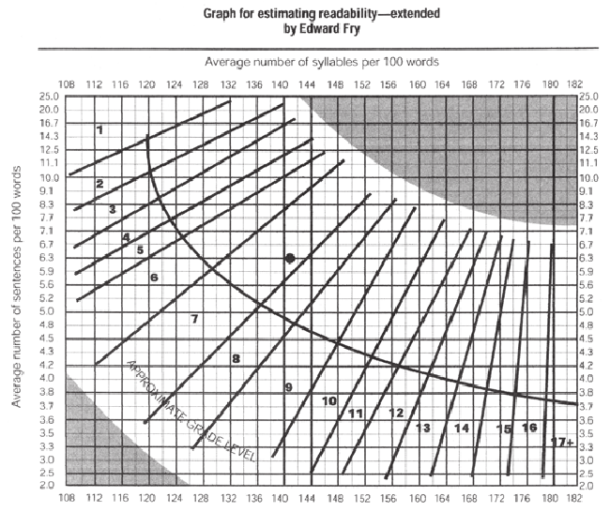
Fry Readability Graph
Source: Fry, E. B. (2002). Readability Versus Leveling. The Reading Teacher, 56(3), 286–291.

Slide 22
Independent Literacy Tasks
Read self-selected books and respond in a journal
Listen to audiobooks and respond to questions
Read in pairs
Read poems and draw a picture in response
Read ebooks
Use buddy reading
Rehearse for readers theater
Read riddles and write out answers
Read texts the class has written together
Use “Record, Check, Chart” to increase reading fluency and rate

