Slide 1
Spelling
Chapter 12

Slide 2
Reflections on Spelling
Have you ever asked in frustration, “How can I look up a word in the dictionary when I don’t know how to spell it?!”
Have difficulties with spelling ever caused you to feel you are not a good writer, or to use only words you know how to spell?
How will you be able to prevent your own students from getting frustrated while learning how to spell?

Slide 3
Developmental Stages of Spelling (Based on Bear et al., 2008)
Emergent
Alphabetic
Within word pattern
Syllable and affixes
Derivational relations

Slide 4
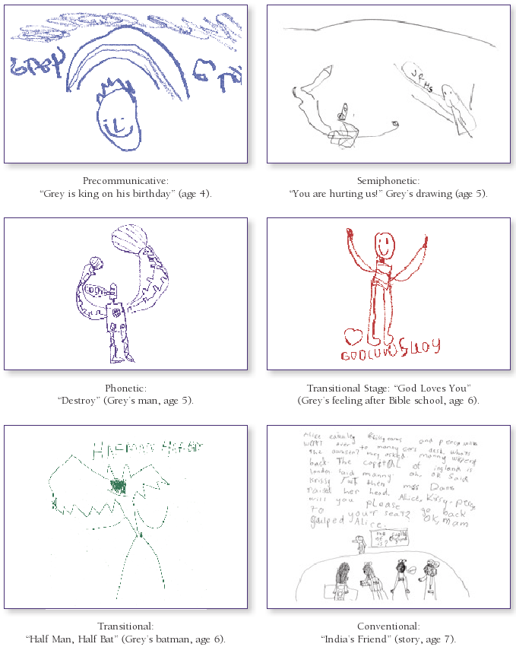
Graphic Examples of Spelling Stages (Based on Gentry & Gillet, 1993)

Slide 5
Instructional Practices for Specific Spelling Stages
Emergent spelling stage:
Provide children plenty of time to write
Demonstrate writing by writing captions under a child’s picture
Share big books and discuss words
Alphabetic spelling stage:
Give plenty of demonstrations and a chance to listen to sounds within words
(continued)

Slide 6
More Instructional Practices for Specific Spelling Stages
Within word pattern spelling stage:
Help students discover patterns within words
Syllable and affixes spelling stage:
Help students see chunks (syllables) in words
Derivational relations spelling stage:
Have students check each others’ papers for errors
Focus on simple spelling rules (such as when to double consonants before -ing)

Slide 7
More Reflections on Spelling
Consider this quote:
Being a word solver “is not so much about learning individual words as it is about learning how written language is organized—how written language ‘works’” (Fountas & Pinnell, 2001, p. 369).
Do you agree or disagree? Why?
Do you think it would be simpler for students, in the long run, to learn how to spell by :
Memorizing words?
Learning principles of orthography?

Slide 8
How Word Solvers Learn Unknown Words
Through sound (phonemic strategy)
Through vision (visual strategy)
Through meaning (morphemic strategy)
Through analogies (linking strategy)
Through inquiry (dictionary usage)

Slide 9
Comparisons Between English and Spanish Spelling Patterns
Both have alphabetic foundations (i.e., phoneme–grapheme correspondence).
But:
English spelling doesn’t mirror pronunciation reliably.
Spanish is considered to have a stronger alphabetic foundation.

Slide 10
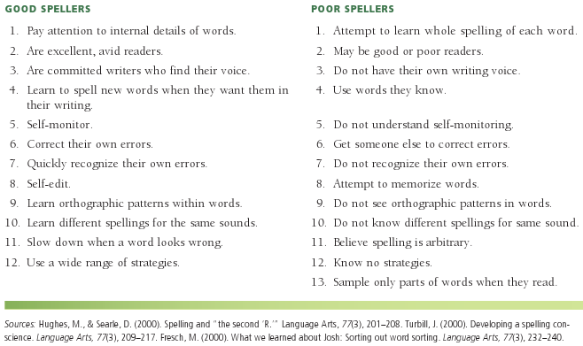
Good vs. Poor Spellers

Slide 11
Assessment for Spelling: Informal
Spelling inventories
CAFÉ assessment (Complexity, Accuracy, and Fluency Evaluation)
Checklists based on state standards

Slide 12
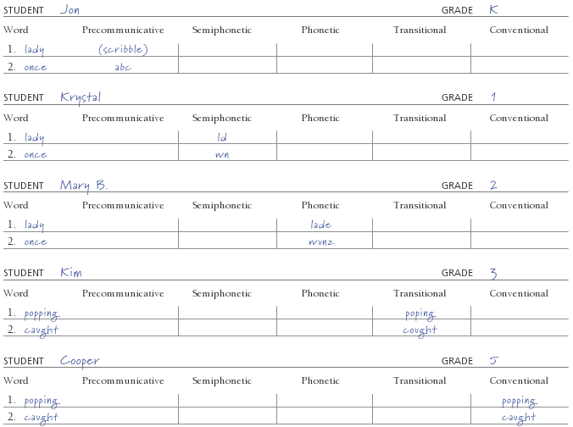
Samples of Recording Students’ Spelling

Slide 13
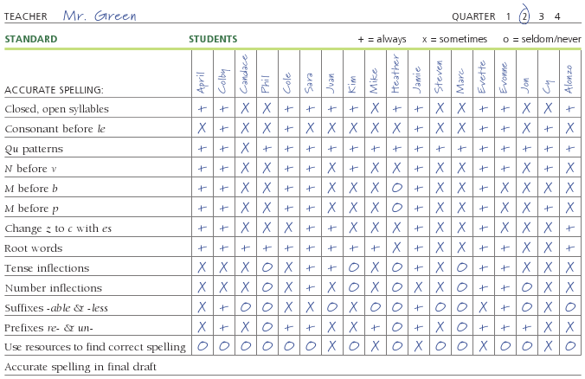
Checklist for Spelling Standards

Slide 14
Assessment for Spelling: Formal
Subtests on standardized tests
In some tests, students are asked to find the correctly spelled word from a list of four or five words.
In other tests, students must find the correct letter combination to fill in a blank in a word.

Slide 15
General Strategies to Help All Students with Spelling
Use visualization, and write the word in the air
Divide words into segments
Focus on similarities and differences between words

Slide 16
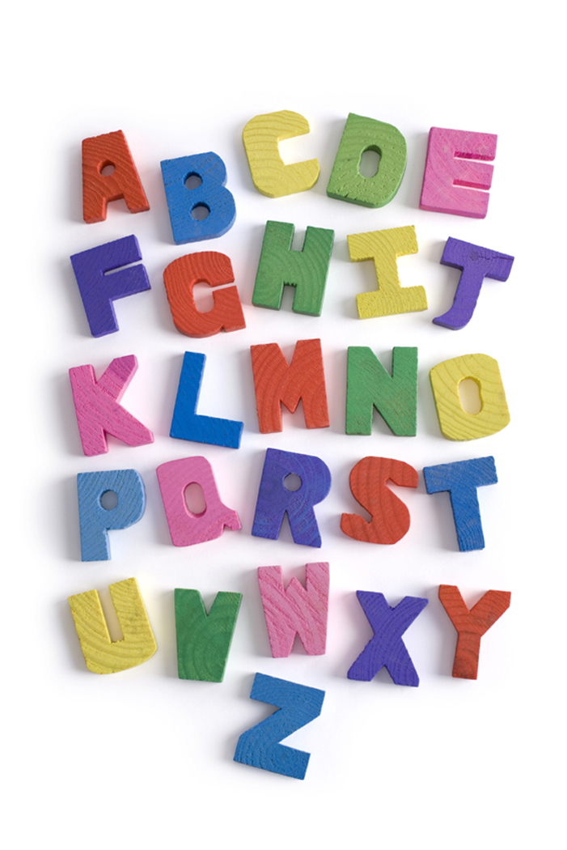
Intervention Strategies Focusing on Spelling
Magnetic letters
Foam board letters
Word searches
Anagrams
Wheel-of-Fortune
Mnemonics, memory aids
Spelling in parts

Slide 17
Spelling and Technology
Spell-check feature of a word-processing program
Internet:
Spelling activities such as word searches and puzzles
www.mindfun.com
www.kidsspell.com
www.funbrain.com

Slide 18
More Reflections on Spelling
Do you find yourself relying too much on a spell-checker, and as a result do you miss a common error (such as there for their)?
How could you encourage students to use spell-checkers but caution them at the same time?

Slide 19
Related Video Presentations
You can see a video on assessing spelling with the CAFÉ Writing Assessment (which is related to the discussion on pages 332–333 of the chapter).

