Slide 1
Writing
Chapter 11

Slide 2
Reflections on Writing
Do you like to write? Do you enjoy journaling or blogging, or recording your thoughts in some other manner?
Do you find you need to revise, or do you usually feel that your first draft is close to perfect?
How will you share your feelings about the writing process with your students?
How will you encourage those who don’t like to write?

Slide 3
Similarities Between Reading and Writing
Use the same cognitive processes:
Gathering ideas
Questioning
Hypothesizing
Use the same cognitive systems:
Semantic
Syntactic
Graphophonic
Pragmatic

Slide 4
Similar Goals/Skills of Reading and Writing (Pinnell, 1999)
To read/write words without conscious awareness
To read/write words without focusing on every letter
To connect unknown words to known words
To focus on chunks of words
To use root words for determining meaning
To connect spelling with meaning
To focus on communicating meaning

Slide 5
Differences Between Readers and Writers
Readers:
Receive messages
Need to be able to understand what others have written
Decode words
Writers:
Create and send messages
Know their audience, choose the best genre, choose words carefully, and choose the best way to share their writing
Encode words automatically so they can concentrate more on expressing themselves

Slide 6
Stages of Emergent Writing (Zecker, 1999)
Drawing
Scribbling
Letter-like forms
Copying
Invented spelling
Conventional spelling

Slide 7
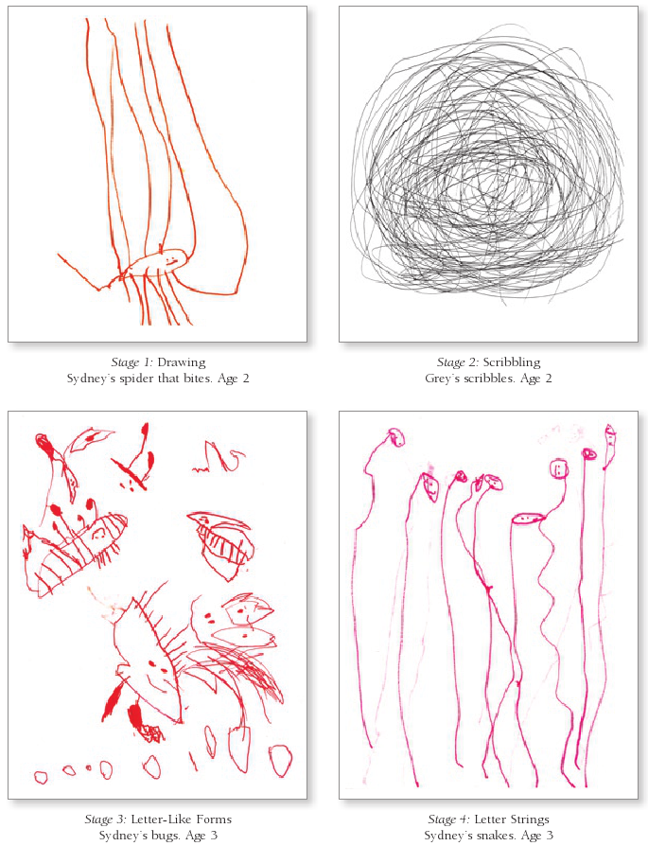
Examples of Writing Stages (Stages 1 through 4)

Slide 8
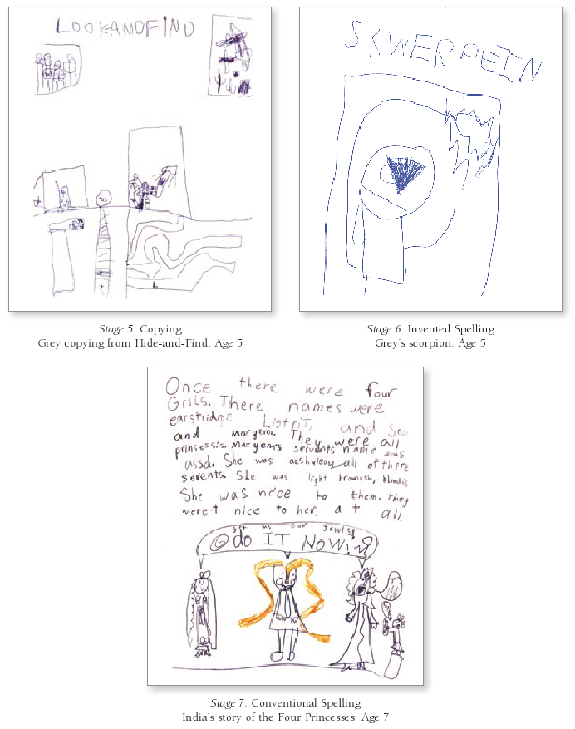
Examples of Writing Stages (Stages 5 through 7)

Slide 9
Instructional Practices for Bilingual Students
Provide extended periods of time for students to write, and allow personal choice of topic and genre.
Encourage students to use their two languages.
Emphasize that students should write original thoughts; tell them not to worry about spelling.
Have students read what they’ve written to you, so you can help with vocabulary.
Value what students write, even if it isn’t long.
(continued)

Slide 10
More Instructional Practices for Bilingual Students
Have students explain how they write, so you can understand their thinking.
Encourage students to use their background knowledge when writing.
Show students where and how they can find correct spellings.
Assess growth by looking at all student writing samples and praise them for their progress.

Slide 11
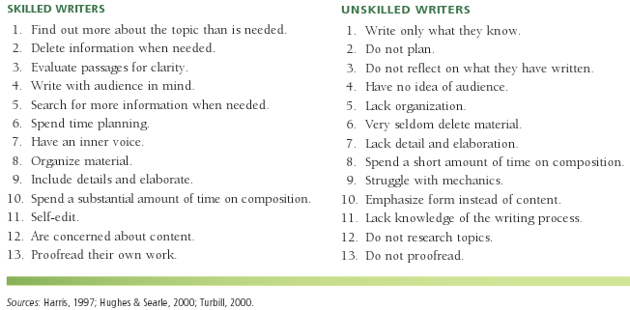
Characteristics of Skilled/Unskilled Writers

Slide 12
Elements of a Writing Workshop
Regular, sustained writing sessions
Choices for students
Teacher and peer feedback
Structure
Cooperative learning community
Mini-lessons for direct, explicit instruction

Slide 13
Steps in the Writing Process
Prewriting
Drafting
Revising
Editing
Publishing

Slide 14
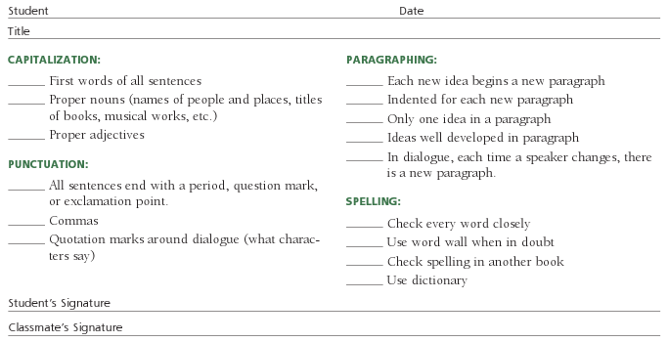
Checklist for Proofreading (second grade)

Slide 15
Evaluating Your Writing Instruction
Evaluate your performance in these areas:
Classroom environment
Instruction
Class schedule
Professional role model
Professional growth
How would you evaluate your own writing skills and abilities? Can you act as a good role model for your students?

Slide 16
6 + 1 Traits
1 Idea / content
2 Organization
3 Voice
4 Word choice
5 Sentence fluency
6 Convention
+1 Presentation

Slide 17
More on the 6 + 1 Traits
Teaching the traits:
Work with each trait during mini-lessons or guided writing, so students are aware of their importance.
Use examples from all types of passages (narrative, expository, poetry, etc.).
Assessing the traits:
Assessment that reflects the traits will encourage students to focus on them.
See www.mshogue.com/ce9/rubrics/rubrics.htm for a sample.

Slide 18
Assessment of Writing: Informal
Portfolios
Rubrics:
Writing process
Writing products
Multi-media projects
Attitude surveys
Self-assessment instruments

Slide 19
Assessment of Writing: Formal
Some standardized tests have language/ grammar subtests.
These test editing ability, not writing.
Many state departments of education have created standardized rubrics to assess writing.
These may cause teachers to show their students how to write so they’ll do well on the test, rather than help them to write creatively.

Slide 20
Intervention Strategies Focusing on Writing
Interactive writing (“Sharing the pen”)
Quick writes (writing on demand)
POW
TREE
(continued)

Slide 21
Some Activities for 6 + 1 Traits of Writing
Trait 1 (Ideas and presentation):
Story about a pet, sport hero, rock star, or friend
Trait 2 (Organization):
How-to procedures
Trait 3 (Voice):
Letter to a fairy tale character
Trait 4 (Word choice):
Poems such as diamante and cinquain
Trait 5 (Sentence fluency):
Combining sentences
Trait 6 (Conventions):
Checklists, word walls, personalized dictionaries
+1 (Presentation):
Computer editing/ illustrating, PowerPoint presentations

Slide 22
More Intervention Strategies
Using concrete examples of authors’ writing
Guided writing
Mt. Plot
Expository frames
Parodies
Sequels
Poetry
Cinquain
Diamante
Biopoems
(continued)

Slide 23
More Intervention Strategies
Response journals
Friendly letters
Wordless books
Noun stories
Classroom alphabet books
Creating brochures
Sentence combining

Slide 24
Concepts to Teach in Guided Writing

Slide 25
Sample Poems
Diamante:
Pizza
Delicious, spicy
Bubbling, steaming, tantalizing
Cheese, mushrooms—scraps, litter
Molding, rotting, decaying
Smelly, yucky
Garbage
Fibbin poem:
Pete
Sprete
Athlete
Plays baseball.
Best pitcher in town!
Easily strikes out ten batters!
Twas only in his dreams that he was such a great star!

Slide 26
Using Computers for Authentic Writing Tasks
Blogs
Wikis
International pen pals
Connecting with authors
Digital storytelling
Publishing on the web
Webquests

Slide 27
Technology and Writing: Word Processing
Helps with drafting/writing/revising (outlining, revising, checking spelling and grammar, etc.)
Gives encouragement to students with messy handwriting
However:
Students still need to decide on a topic, articulate ideas, have a good understanding of grammar, and be able to recognize correct spelling

Slide 28
Related Video Presentation
You can see a video in which a student shares his expository writing (which is related to the discussion on page 294 of the chapter).

