Slide 1
Fluency
Chapter 10

Slide 2
Reflections on Fluency
Have you ever been to a book reading where the author read her material very slowly and monotonously?
Were you able to follow the narrative?
How were you able to prevent yourself from daydreaming or dozing off?
How can you make sure your students don’t have similar problems when reading aloud?

Slide 3
Introduction to Fluency
Fluency is the ability to read with automatic word recognition, expression, and meaning.
What does fluency entail? Fluent readers:
Read at a good pace
Attend to the punctuation in sentences
Recognize words automatically
Quickly decode unknown words
Slow down when needed
Use expression when reading aloud

Slide 4
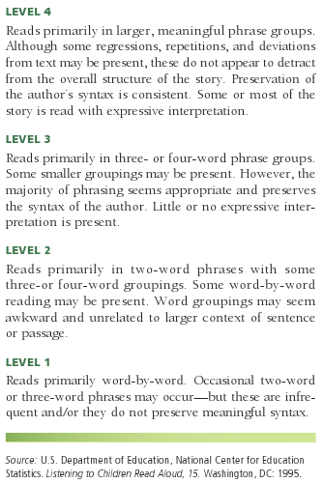
NAEP’s Oral Reading Fluency Scale

Slide 5
Components of Fluency
Rate
Automaticity/accuracy:
Recognizing common words
Associating letter/letter combinations with their sounds
Recognizing chunks/syllables within words
Recognizing the meanings of words
Prosody/phrasing
Parsing phrases
Expressive reading
Punctuation
Comprehension

Slide 6
Traits of Fluent Readers
Use knowledge of language to keep reading
Use an appropriate reading rate
Slow down to solve problems
Have automatic word recognition and word analysis skills
Use intonation to convey meaning
Adhere to punctuation cues
Use knowledge of story structure and expository text to keep reading
Reproduce the natural phrasing of the text

Slide 7
How Punctuation Can Change Meaning
A panda eats, shoots, and leaves.
The panda goes into a restaurant, orders a meal, eats it, shoots a fellow diner, and then leaves.
A panda eats shoots and leaves.
The panda eats the shoots and leaves of a bamboo plant.

Slide 8
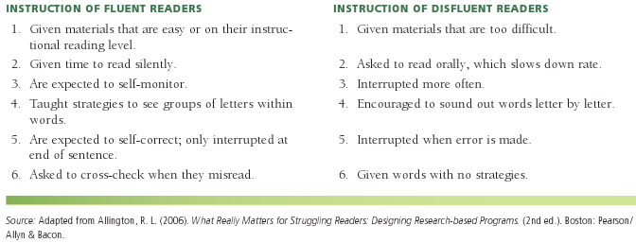
Typical Instruction Given to Fluent and Disfluent Readers

Slide 9
Fluency Instruction for English Learners
The teacher reads a short passage (on the student’s instructional level) to the English learner.
The teacher and learner read the passage together.
The learner reads the passage so the teacher can assess progress.
The teacher times the learner’s reading, to record reading rate.
The learner practices to increase rate and improve intonation.
The learner listens to a recording of his/her reading to self-assess.

Slide 10
Assessment of Fluency: Informal
Checklists
Running records
Miscue analysis
Retrospective miscue analysis
Rubrics
Informal commercial assessments

Slide 11
Assessment of Fluency: Formal
Calculate rate and/or accuracy; for example:
Stanford Diagnostic Reading Test
Gray Oral Reading Tests
Gilmore Oral Reading Test
Durrell Analysis of Reading Difficulty
Diagnostic Reading Scales, Revised
Woodcock Reading Mastery Test
Instruments do not allow teachers to assess other components of fluency

Slide 12
Rubric for Reading Comprehension Based on Illinois’s Standard 1.B.1d for Early Elementary School English/Language Arts

Slide 13
Suggested Fluency Instruction for English Learners
Teacher reads a short passage (on the correct reading level) to the student.
Teacher and learner read the passage together.
Learner reads the passage so the teacher can assess progress.
Teacher times learner’s reading, to record reading rate.
Learner practices to increase rate and intonation.
Learner listens to a recording to self-assess.

Slide 14
Intervention Strategies Focusing on Fluency
For tutoring settings:
Echo reading
Preview-pause-prompt-praise (PPPP) strategy
Oral recitation lesson (ORL)
Carbo Recorded-Book Method
Record, Check, Chart
Flash cards
(continued)

Slide 15
Sample Record, Check, Chart

Slide 16
More Intervention Strategies
Strategies to use with small groups:
Fluency development lesson (FDL)
Speech reading
Telling jokes
Supported-reading strategy
Dyad reading
Repeated readings
Poetry party
Readers theater
Choral reading
Rhythm walks

Slide 17
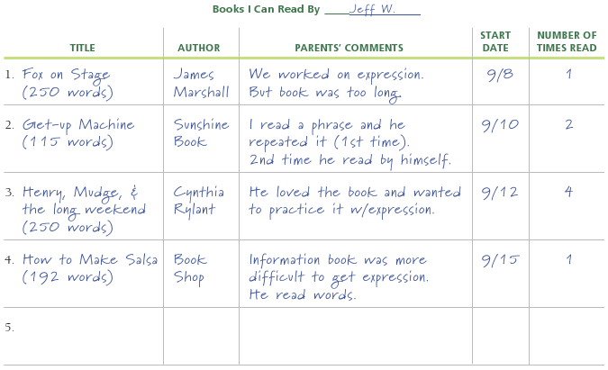
Sample Fluency Log

Slide 18
Fluency and Technology
Audiobooks—to follow along, or read along with the narrator
Reading Assistant Expanded Edition—speech recognition software
Read-along radio dramas
Websites with free scripts for readers theater

Slide 19
Related Video Presentation
You can see a video presentation on direct instruction in fluency with echo reading (see echo reading in action; this is related to the discussion on pages 270–271 of the chapter).

