Slide 1
The Black Plague
1347 A.D. -1351 A.D.

Slide 2
The black plague
In this lesson, students will be able to identify the cause and effect of The Black Plague
In this lesson, students will be able to identify and/or define the following terms
Trade Routes
“Black Death”
Reoccurrence

Slide 3
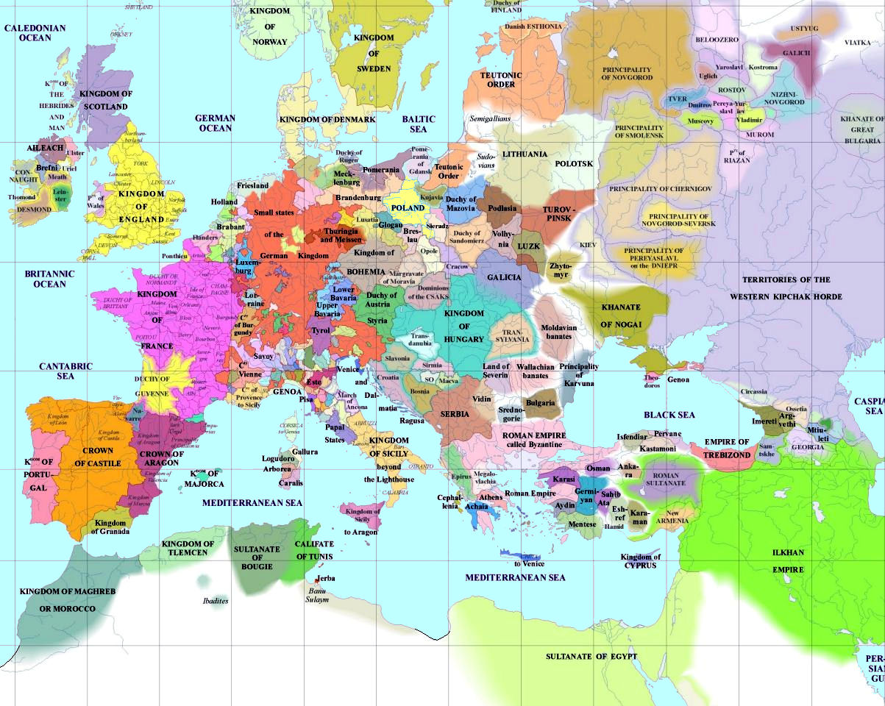

Slide 4
Revival of trade
After the collapse of the Roman Empire in the 400s, trade almost died out in western Europe.
As a result of manors, towns and cities that depended on trade and manufacturing, shrank in population.
Because of the Crusades, trade began to grow again in Europe.
Italy was the earliest site of this trade revival.
Location was a major factor in trade.

Slide 5
Demand for goods
The Crusades increased the Europeans’ demand for goods from Asia, especially goods considered “exotic” or new.
Highest profits came from trading in luxury goods, such as dyes, medicines, silks, and spices.
Europeans also wanted manufactured goods such as cotton cloth, linen, and art objects.
Asia supplied Europe with fruit, grain, and rugs.
Europe offered its own goods in exchange.

Slide 6
Population growth
During the Middle Ages, most northern and western European cities had fewer than 2,000 people.
By the 1200s, about 150,000 people lived in Paris.
Manor life changed. Where serfs once paid the manor lord with labor, then could now pay their lord with money.
Cities stood on hilltops or lay along river bends. Most cities had little land, so houses were built several stories high.
The tall buildings created dark and narrow roadways below.

Slide 7
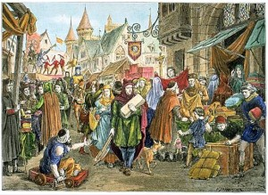

Slide 8
A recipe for disaster
The growing cities were an exciting place
Many were dark, unsafe, dirty, and unhealthy
There were no streetlights or police.
People did not go out alone at night for fear of robbers.
Trash was dumped in open gutters and on streets.
As a result, diseases spread quickly.

Slide 9
The black plague of 1347
Since the trades routes had increase, Asia became the popular choice of trade.
The Black Plague arrived in Europe in 1347. Traders on route from Asia brought along infected rats. They made many stops along the way.
Literally overnight, entire villages and towns were wiped out.
It is estimated that 25 million people, roughly one-third of Europe’s population.

Slide 10
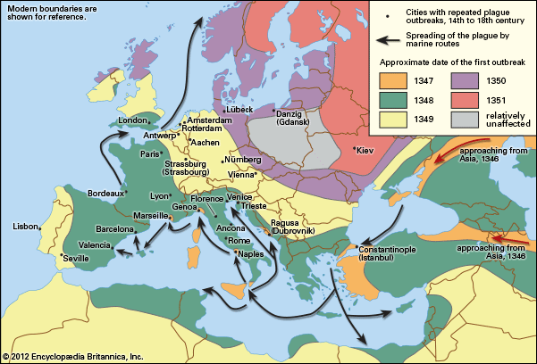
The Spread of the Black Plague

Slide 11
It keeps going and going….
The Black Death claimed more lives than any war until the twentieth century.
The terror did not end. The plague came back again and again.
New outbreaks occurred in 1361, 1369, 1374, 1390, and on into the 1600s.
The repeat outbreaks were never again as severe as the first outbreak. But now plague became a constant fear.

